Slide 1
Helpdesk Ticket Summaries
By Beng Ren Siew

Slide 2
Overview
The dataset is a collection of helpdesk tickets that displays problems/incidents and request for software and IT. The primary goal is to provide timely solutions to the problem for each ticket

Slide 3
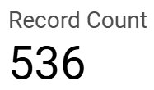
Summaries
This Record Count is indicating the total number of tickets within the dataset.

Slide 4
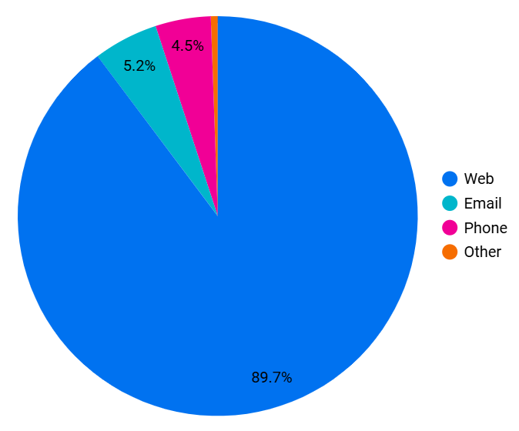
Summaries
This Pie Chart indicates the percentages of the source of where the tickets come from.
89.7% of tickets come from the Web which is equivalent to 481 tickets
Email – 5.2% → 28 tickets
Phone – 4.5% → 24 tickets
Other – 0.6% → 3 tickets

Slide 5
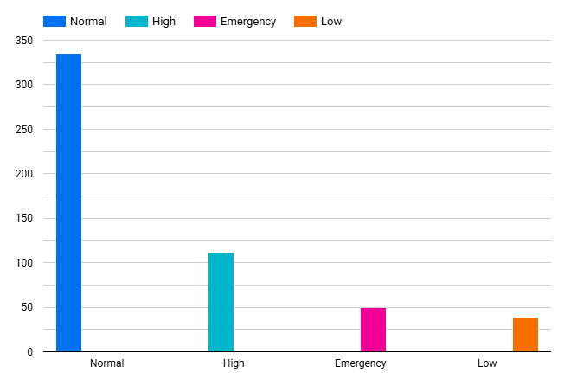
Summaries
The graph displays the total number tickets for each different priority within the dataset.
This graphs indicates that a majority of tickets fall under normal priority.

Slide 6
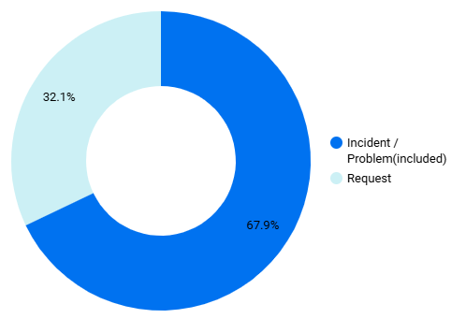
Summaries
This shows the percentage of the type of tickets in the dataset. They are either:
Incidents/Problems → 364
Requests → 172

Slide 7
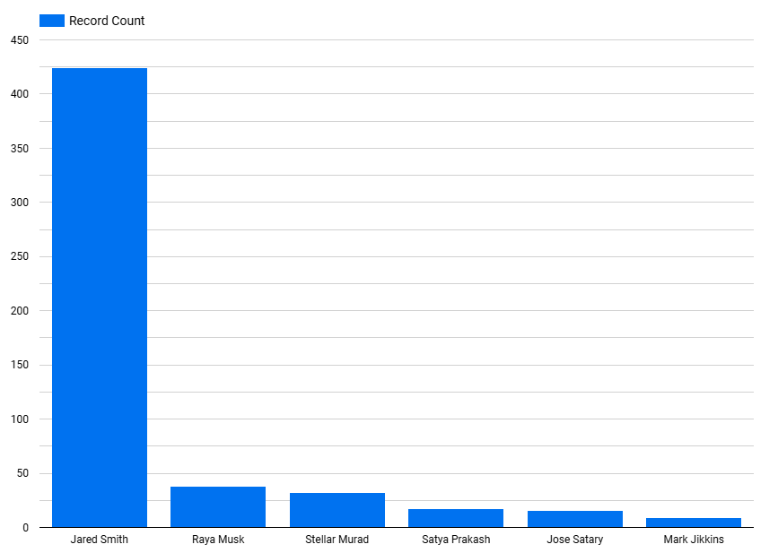
Summaries
The graph shows the total amount of tickets each individual in the Helpdesk team has undertaken in the dataset
Jared Smith → 424
Raya Musk → 38
Stellar Murad → 32
Satya Prakash → 17
Jose Satary → 16
Mark Jikkins → 9
This graph provides an indication on the progress and workload of each individual within the helpdesk team.

Slide 8
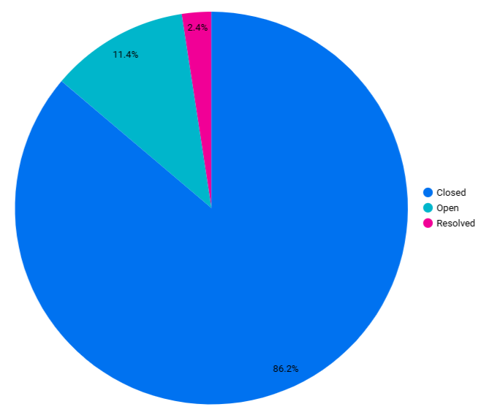
Summaries
This pie chart provides the percentage of closed, open and resolved tickets at the given instance of the dataset (Current Status).
Closed – 462
Open – 61
Resolved – 13
A resolved ticket is when the support agent has addressed the ticket, but may require user confirmation or follow-up hence not fully closed.

